Slide 1
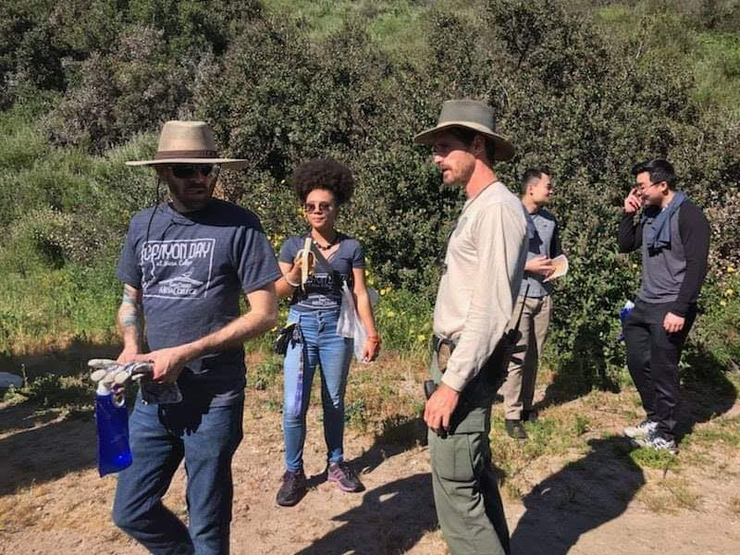
Stepping into Guided Pathways
with the Student Journey in Mind
June 5, 2019

Slide 2
Presented By the ASCCC
Jessical Ayo Alabi – Orange Coast College, Chair of Sociology, Guided Pathways Onboarding Faculty Coordinator, ASCCC Faculty Lead --In year 2 of Guided Pathways; wrapping up Inquiry
Janet Fulks – retired Bakersfield College, ASCCC Faculty lead, Capacity Building -- In year 5 of Guided Pathways
Ty Simpson – San Bernadino Valley College, Counselor, Guided Pathways Faculty lead, ASCCC Lead Faculty --In year 1 of Guided Pathways
Notes:
Fill in your content

Slide 3
Icebreaker
FINISHED FILES ARE THE RESULT OF YEARS OF SCIENTIFIC STUDY COMBINED WITH THE EXPERIENCE OF YEARS.

Slide 4
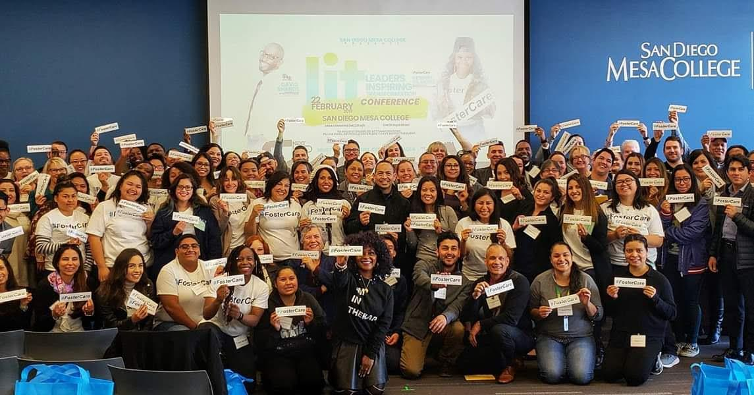
STUDENT PANEL QUESTIONS
What process(es) did you use in determining your educational goals and major?
Have you changed your major and how confident do you feel with your current educational goal/major choice?
How long have you been at Mesa? Have you taken courses at other colleges?
What kind of support, if any, has been especially helpful during your time here at San Diego Mesa College (include all support: financial aid, academic support like the STEM Center or the Learning Center, EOPS, Counseling, library, DSPS, the Stand) and how were you made aware of the services?
How do you choose your class schedule? Are classes available and are they offered at times that fit your schedule?
What has been hard regarding accomplishing your dreams/goals at Mesa?
What has worked well for you at Mesa?
Notes:
Ty will get the questions together and collaborate with Tony and Howard on getting information for questions and interacting with students

Slide 5
Notes:
Shifting from Institutional View to student perspective

Slide 6
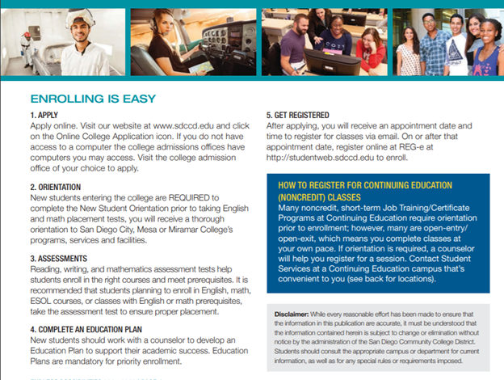
Notes:
San Diego Mesa website

Slide 8
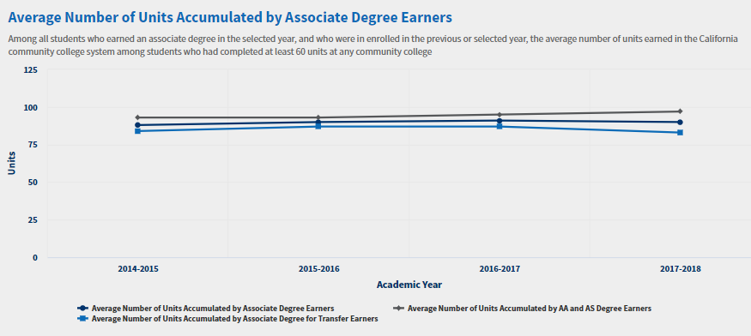
MESA is Getting it Right!
Leading college of equity and excellence! This is the BIG picture.
Active faculty contributing statewide, innovative and engaged
Student-driven decisions
1 of 15 CCC granting a B.S. in Health Information Management
Data-informed decisions
The ADTs (716) now outnumber Local AAs and ASs (686)
Notes:
Translate this difference into time – 14 units is one year or more

Slide 9
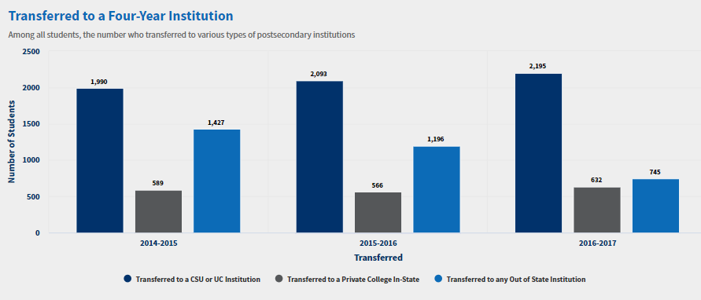
What We Know About MESA
Large shift to in-state transfers
NB a large number transfer who do not declare it
Declared: CSU UC 1623 CA private 390 Out-of –State 510
What does this mean in terms of guiding students during onboarding, intervention during a student’s journey, mapping and aligning PSLOs and other academic support services?
Notes:
If students were introduced to their majors earlier it would have benefitted them?

Slide 10
Great English & Math Completions
You have just worked on Program Pathways from the Institutional Perspective now change seats

Slide 11
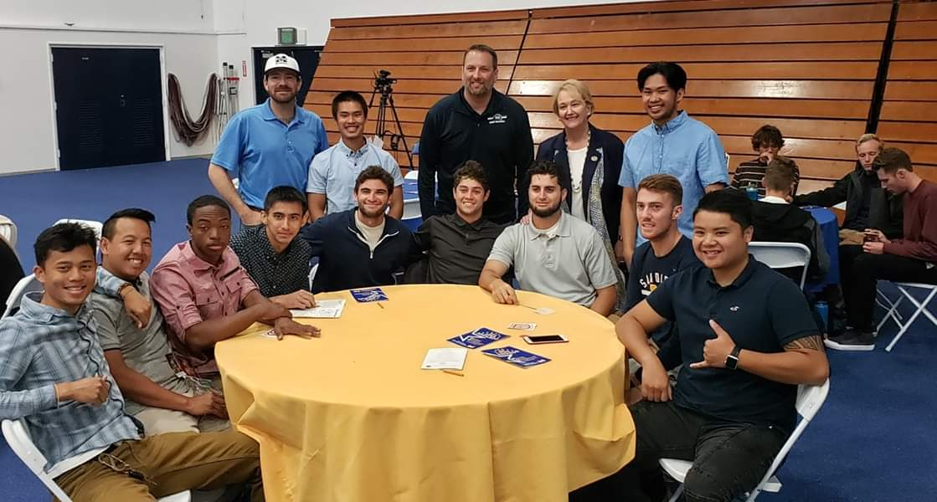
Become a MESA Student
Assume that you are new to Mesa
You intend to go to college full time and work about 10 hours per week
You are at college level in Math, English or ESL but are a first generation college student
Your intention is to complete in 2 years, transfer and get a job to help your family ASAP

Slide 12
Plan the Next 2 Years of Your Life...
Using your phone (as students do today), prepare a two year plan to complete your chosen degree
We have selected the top 4 degrees awarded last year at Mesa and assigned one per table
AS-T Business Administration-0505 282 awards
AA Biological & Physical Sciences (& Mathematics)-4902 154 awards
AA-T Psychology, General-2001 118 awards
AA Liberal Arts & Sciences, General-4901 98 awards

Slide 13
Create Your Schedule (15-18units per semester)
Semester 1 | Units | Require-ment
Semester 2 | Units | Require-ment
Semester 3 | Units | Require-ment
Semester 4 | Units | Require-ment

Slide 14
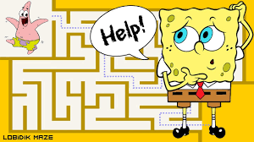

Slide 15
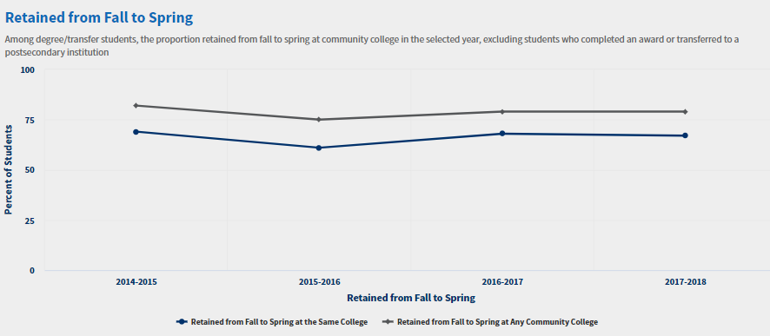
How a “Pathways Redesign” of Mesa’s Schools May Serve MESA Students...
NB Those students who declared transfer were retained at higher rates
Declared retained at SD Mesa at 66.6%; undeclared 62.3% at SD MESA
Declared retained at any college at 78.6%; undeclared 75% at SOME CCC
Notes:
From Fall to Spring SD MESA lost 5,574 students – some may have graduates but 3,582 = 1992 students were lost to other CCCs

Slide 16
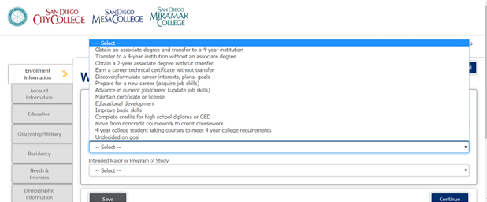
Welcome to San Diego Mesa

Slide 17
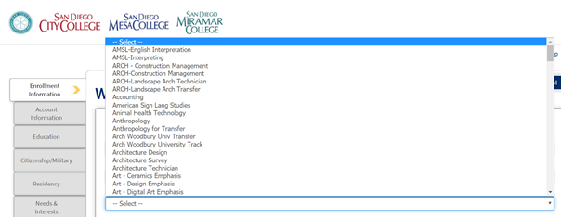
Pick a Major: 9 Screens of Choices
Notes:
Who does this alpha order benefit? DO you think students know what IGETC or LAS stand for?

Slide 18
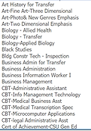
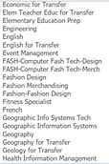
Pick a Major: Overwhelming Choices

Slide 19
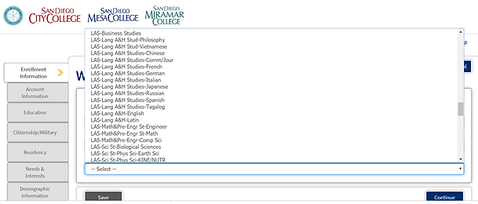
...Pick a Major

Slide 20
What’s the Student Experience Like?
Comments – is alpha order good?
Do students understand the degree and certificate lingo?
Who scrolls through all of this?
Is this why programs near Z have fewer awards?
Discuss Schools-where would you look for architecture? English? Dance? Languages? Interior Design? Construction?
How does a student understand the difference between a Certificate of Performance, a Program, and Transfer?

Slide 21
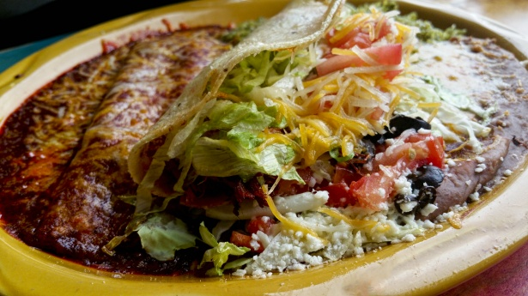
Lunch

Slide 22
Transparency, Honesty, Mutual Respect, Grace
Confronting FEAR
Creating MESA’s Guidelines
Building “Trust for Change”.
Learning from our Peer’s Strides and Mistakes...

Slide 23
Institutional
Comprehensive Diversity Framework
Grounded In Equity
Leaders as Learners
Critical Consciousness
Communication
Integration
Alignment of vision with practices
Benefits to Students
Planned exploration of careers & opportunities within a field of study
Awareness of career and academic milestones
Clarity regarding requirements for completion
Fewer excess units taken
Students make informed choices about their majors and coursework
Higher rates of course completion and graduation

Slide 24
Alignment with the OCC mission:
• Opportunities for interdisciplinary collaborations/ communities within clusters
• Cross-college, cross-functional, large Pathways Design Team made up of students, classified, faculty, and managers to breakdown various silos for inquiry design
• Presentations to Senates, Councils, and Committees in existing governance structure to be transparent, encourage departmental initiatives, and maintain momentum
• Desired cluster-specific counseling at or near the top layer and earlier exposure to career opportunities (internships, job shadowing, campus employment)

Slide 25
“Top-down” and “Bottom-up” approaches:
• Deciding between traditional academic headings or innovative descriptive headings
• Sorts done by design team, student focus groups, classes, departments, senate, etc.
• Program sorts by student groups and design team
• Looking at interdisciplinary communities with shared attributes, no just programs
Based on principles:
• Clarity/simplicity for student mobility
• Not “job market vs. transfer” but types of job markets
• Math requirements
• GE patterns for AA and transfer degrees
• Simplifying decision-making with the end in mind

Slide 26
Principles:
Identify student barriers
Assess current pathways (Basic Skills, Placement, ADT, C-ID, new)
No programs or courses would be lost in the first year
After 1 year any potential re-evaluation would go through program review/vitality (PRC) and curriculum committee by normal processes
Align expectations with K-12 and transfer partners
Clarify pathway components (enrollment management, cross-disciplinary discussions)
Identify and embed appropriate student support structures
Be inclusive of ideas not exclusive
Get a draft to go forward but commit to re-evaluate on a particular date
Take all considerations through Participatory governance committees

Slide 27
Pathways work should:
Make clear for students, required course selections and sequence depending on their education and career goal(s)
Articulate the purpose of each course and outline specific skills gained as they apply to a student's career focus
Reduce the risk of students getting l
ost in the process of their goal completion Identify preemptively, areas along the pathway to insert specific and intentional supports in order to keep more of our students successfully on the path
Result in more fruitful, innovative services to our students
Help students complete their goals in less time and reap the rewards of transitioning directly into their intended next step either their career goal or into their next level of education
Notes:
Their Guidelines were in paragraph form so I had to reduce and bullet them

Slide 28
Grossmont continued...
Enable students to meet their educational (certificate, degree, transfer) and career goals sooner without unnecessary detours and without excess units that deplete their financial aid
Create enriched learning experiences would stem from intentional, collaborative, and interdisciplinary curricular design
Result in greater collaboration across disciplines to develop coherent program SLO's that will streamline the learning for our students
Make the system easier to navigate
Increase collaboration with K-12 and our Transfer Institutions

Slide 29
None of this is a commitment to anything – it is an exercise in field observations
Look at the worksheet “What is in a Name?”
Talk about the advantages of Mesa “Schools” for the Institution and for the Students.
Review some of the metamajor’s names – check the ones you like, cross off the ones you don’t like and create some others – with notes
Look at the samples make notes on what you like and do not like about the clustering of programs
.

Slide 30
Citrus Career and Academic Pathways
Notes:
Some examples - no magic number no magic names no easy formula

Slide 31
Lake Tahoe

Slide 32
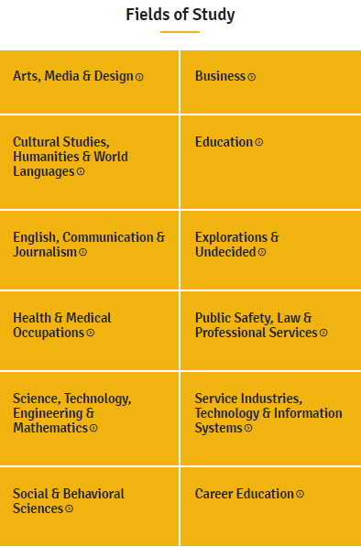
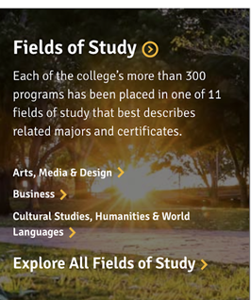
Southwestern Fields of Study

Slide 33
Sierra College

Slide 34
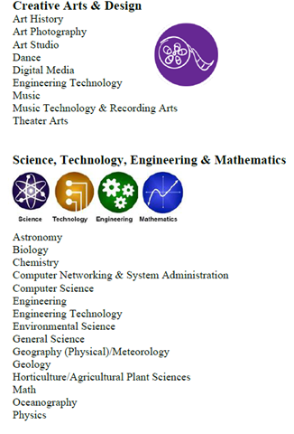
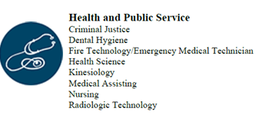
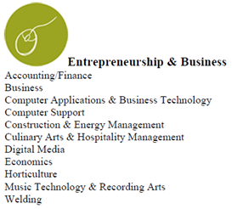
Cabrillo’s Career and Academic Pathways (CAPs)

Slide 35
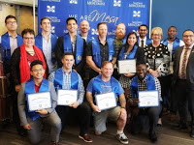
Benefits of a Redesign…
...no matter what you call it!
Institution - Student case management, data, messaging, milestones, collegial dialogue
Faculty - engagement in the important cross-disciplinary PROGRAM dialogue
Students - clarity, decreased units, decreased time, helpful exploration, clear paths and clear options, connection to real careers

Slide 36
What’s in the Data?
The DATA are OUR STUDENTS with real lives, goals, fears, problems, and triumphs.
Qualitative versus Quantitative: The narrative; what story are we missing?
Data mining: What information have students already given us, but we have ignored, overlooked, obscured it?
Faculty and Student Services Classified Employees: Are we overlooking embedded data experts because of structures and processes?

Slide 37
Benefits of a Redesign for MESA
Leading college of equity and excellence!
This is a tool to address gaps
This provides clarity and support for those not “lucky” enough to have it
Clustering helps students to navigate the college but more importantly career opportunities and future education needs
Can provide embedded support structures with customized needs assessment

Slide 38
A Journey--not a Destination
An iterative process is a process for developing a desired result by means of repeated inquiry, planning, implementation, evaluation, analysis, and back to planning.
convergence
closer to outcome with each iteration
Review questions and determine guidelines for MESA
Join the Workgroup
Create a timeline

Slide 39
Thank you for inviting us!
Q & A

Slide 40
Academic Senate for
California Community Colleges Resources
ASCCC GP Canvas - https://tinyurl.com/CCC-GP2018
ASCCC Guided Pathways RESOURCES https://www.asccc.org/guided-pathways
Our Guided Pathways Task Force is made up of experienced, specialized faculty from across the state, who are happy to facilitate workshops, trainings, meetings, and dialogue at your campus at no charge to you. Please go through your academic senate president to submit a request for a Guided Pathways campus resource visit through the website above.

