Slide 1
Housekeeping and ASCCC Resources
ASCCC GP Canvas - https://tinyurl.com/CCC-GP2018
ASCCC Guided Pathways RESOURCES https://www.asccc.org/guided-pathways
Welcome! We’ll be with you shortly
The chat will be used for questions and input
All attendees will be muted
Notes:
Randy

Slide 2
Developing Practices and Materials for Counseling
Presenters:
Randy Beach, ASCCC Guided Pathways Lead, Southwestern College
Janet Fulks, ASCCC Guided Pathways Lead, Capacity Building
Ty Simpson, San Bernardino Valley College, Guided Pathways Task Force
Teresa Aldredge, Counselor/Umoja Diop Scholars Coordinator
Cosumnes River Colleges
Notes:
Randy

Slide 3
Thank you for joining us for the ASCCC GP webinars
Webinars will be back in fall 2019!
Notes:
Randy

Slide 4
Want MORE Guided Pathways?
Jul. 10-13, Curriculum Institute, Burlingame​​
Sept. 13-14, 2019 Academic Academy, Long Beach
Notes:
Randy

Slide 5
Developing Practices and Materials for Counseling
Guided Pathways BEGINS with the correct connection between the student's goals and reasons for attending college and the types of programs, scheduling and exploration available for students. How do we meet students where they are at and help them understand pathways and support available to help create rigorous goals and realistic plans. Join us as we begin to look at Guided Pathways counseling tools.
5/22/2019 Noon – 1:00 PM
Notes:
Randy

Slide 6
Research*: Thinking about Academic Advising in a New Way
GP asking colleges to rethink paradigms around counseling
Counselors receive lots of student input, but how do we collect this, validate and use it to improve the college?
How do we use advising to give students voice?
*From Bourdon and Carduzzi (2002) in What Works in the Community Colleges: A Synthesis of the Literature on Best Practices
Notes:
Randy- Counselors as a data source and an asset in planning and incorporating student voice

Slide 7
Thinking about Academic Advising in a New Way
“Students are likely to persist in their efforts at learning when they feel they are in control. Students are likely to feel in control when the factors attributed to their outcomes are seen as internal, stable and controllable.”*
*Schunk, D. H., & Zimmerman, B. J. (2006). Competence and Control Beliefs: Distinguishing the Means and Ends. In P. A. Alexander & P. H. Winne (Eds.), Handbook of educational psychology (pp. 349-367). Mahwah, NJ, US: Lawrence Erlbaum Associates Publishers.
Notes:
Randy

Slide 8
“Transforming Advising within a Guided Pathways Context.” Melinda Mechur Karp, Ph.D., September 30, 2016
Notes:
Randy/TY

Slide 9
“Transforming Advising within a Guided Pathways Context.” Melinda Mechur Karp, Ph.D., September 30, 2016
Notes:
Randy/TY

Slide 10
Transformation?
What is the field saying?
ASCCC counseling survey distributed in May 2018
“The Transformation of counseling Along Guided Pathways Sidelines” Rostrum article in October 2018
Identifies key questions and upcoming challenges
“The Transformation of Counseling Along Guided Pathways Sidelines,” My-Linh Nguyen, Cuyamaca College, Rostrum October 2018
Notes:
Randy/TY

Slide 11
Key Questions and Areas to Explore
Where are counselors being located on campus?
How are counselor assignments and duties being assigned?
How do adjunct counselors fit in?
How is counseling coverage managed in a caseload or pathway structure?
How does GP affect other areas of student services, such as categorical programs?
How are counseling “peak-times” managed?
Are paraprofessionals being used, and if so, how?
“The Transformation of Counseling Along Guided Pathways Sidelines,” My-Linh Nguyen, Cuyamaca College, Rostrum October 2018
Notes:
Randy/TY

Slide 12
Challenges for the Future
Staffing and space
Understanding guided pathways and what it means to the counseling discipline
Time and Planning
Counselor involvement
Time and planning
Organized Guided Pathways Design Teams
Research, consultations, and discussions
“The Transformation of Counseling Along Guided Pathways Sidelines,” My-Linh Nguyen, Cuyamaca College, Rostrum October 2018
Notes:
Randy/TY

Slide 13
How have your counseling faculty’s role changed as you implement guided pathways?
?????
Please place your responses in the chat
Notes:
Randy

Slide 14
High Touch Counseling Tools
Making people available as a core institutional value
Student education plans with guided pathways in mind (program mapping, fields of study, etc..)
General orientation
Differentiated orientation (more later)
Notes:
TY

Slide 15
High Touch Counseling Tools
Outreach to elementary /middle / high schools
Inreach to enrolled students
Postcards and other low-tech, human correspondence
Video conferencing (low-tech/human-initiated)
Online counseling (low-tech/human-initiated)
Teaching, not Telling (high touch interaction to help student learn key processes)
Notes:
TY

Slide 16
Has your college experimented with embedded counselors within schools or metamajors? If so, how is it working?
?????
Please place your responses in the chat
Notes:
Randy

Slide 17
Differentiated Orientation
Tailored orientation materials and experiences for special populations
Adds to your equity tool kit
Provides focused information based on past student needs
Creates community and a support system around individual students with a “human element”
Notes:
TY

Slide 18
High Tech Counseling Tools
Student profile systems for case management counseling
Early alert systems
Appointment setting software
Career exploration tools and websites
Tools to audit student progress
Online orientations
Articulation sites (ASSIST.org)
Guided Self-Placement tools
“Degree with a Guarantee”
Notes:
TY

Slide 19
What tools have you found to be engaging for students since you began to design and implement a guided pathways framework?
?????
Please place your responses in the chat
Notes:
Randy

Slide 20
Orientation and Career Exploration Processes
Career counseling as a more intentional part of the comprehensive educational plan
The Educational Planning Initiative as a tool to work with students https://cccedplan.org/
Career Coach and other technologies https://www.economicmodeling.com/student-success/
Building strong industry partnerships and collaborations
Onboarding and Offboarding Internships
Notes:
Janet / Randy

Slide 21
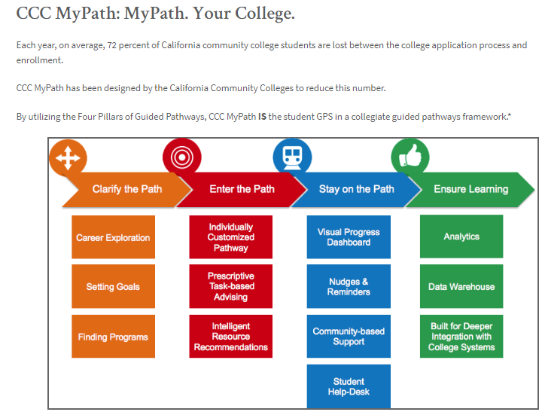
No Cost
College Configurable
Complements / supplements existing onboarding
https://cccedplan.org/ccc-mypath/ccc-mypath-overview
MYPATH Webinar
Wednesday, March 13, 2019
epi@ccctechcenter.org.
Notes:
Janet: Free tools from Mypatyh for all CCCs
Recorded session of my path from Feb and Jan

Slide 22
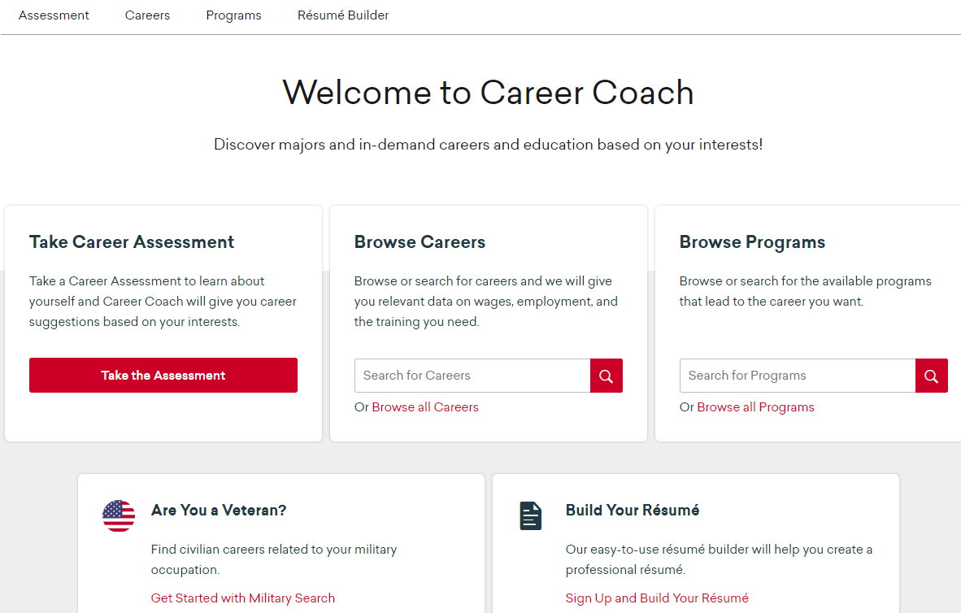
Notes:
Janet: A customized career coach implementation

Slide 23
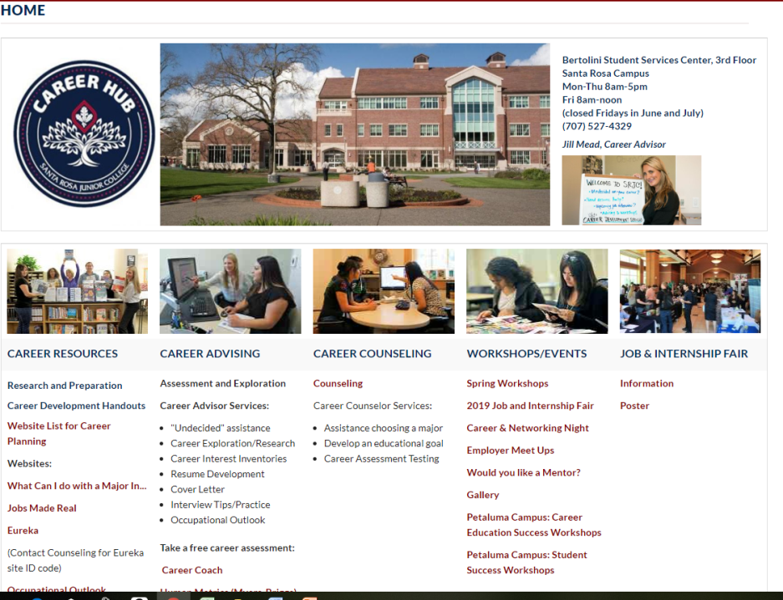
Notes:
Janet: Another customized version

Slide 24
Questions and Comments

Slide 25
Additional Resources
ASCCC GP Canvas - https://tinyurl.com/CCC-GP2018
ASCCC Guided Pathways RESOURCES https://www.asccc.org/guided-pathways
“The Transformation of Counseling Along Guided Pathways Sidelines” My-Linh Nguyen, Cuyamaca College, Rostrum October 2018
Bourdon and Carduzzi (2002) in What Works in the Community Colleges: A Synthesis of the Literature on Best Practices
*Schunk, D. H., & Zimmerman, B. J. (2006). Competence and Control Beliefs: Distinguishing the Means and Ends. In P. A. Alexander & P. H. Winne (Eds.), Handbook of educational psychology (pp. 349-367). Mahwah, NJ, US: Lawrence Erlbaum Associates Publishers.
“Transforming Advising within a Guided Pathways Context.” Melinda Mechur Karp, Ph.D., September 30, 2016

Slide 26
Thank you for joining us for the ASCCC GP webinars
Webinars will be back in fall 2019!
Notes:
Randy

