Slide 1
Housekeeping and ASCCC Resources
ASCCC GP Canvas - https://tinyurl.com/CCC-GP2018
ASCCC Guided Pathways RESOURCES https://www.asccc.org/guided-pathways
Welcome! We’ll be with you shortly
The chat will be used for questions and input
All attendees will be muted
Notes:
Randy

Slide 2
Partnering with High Schools: Secrets and Good Practices
Presenters:
Jessica Ayo Alabi, Ph.D. Chair & Professor of Sociology, Orange Coast College
Randy Beach, ASCCC Guided Pathways Lead, Southwestern College
Kimberly Bligh, Bakersfield College Summer Bridge Director
Ty Simpson, San Bernardino Valley College, Guided Pathways Task Force
Carrie Roberson, ASCCC North Representative, Guided Pathways Task Force- Chair
Notes:
Randy

Slide 3
Two Webinars Next Week
The Reality of Metamajor and Program Mapping Work
Many colleges feel that the development of metamajors and program maps is the totality, or at least a major portion, of the Guided Pathways work, but is that true? Can you just create metamajors and program maps and be done with Guided Pathways? Colleges are spending significant time and effort engaged in sorting activities, which may assist in beginning the conversation, but is that the best data to use in this transformative process? What have colleges learned in the metamajor and program map development process and how may you benefit from their insights?
3:00–4:30 PM (May 22, 2019)
Developing Practices and Materials for Counseling
Guided Pathways BEGINS with the correct connection between the student's goals and reasons for attending college and the types of programs, scheduling and exploration available for students. How do we meet students where they are at and help them understand pathways and support available to help create rigorous goals and realistic plans? Join us as we begin to look at Guided Pathways counseling tools.
Noon – 1:00 PM (May 22, 2019)
Notes:
Randy

Slide 4
Partnering with High Schools: Secrets and Good Practices
We only have students for two years; reaching out to our high school partners is important to scaffold the concepts and decision making that provide students with the agency and autonomy they need to be successful in the time we have them. This webinar covers a variety of linkages from Summer Bridge to dual enrollment to early counseling interventions. Join us as we reveal secrets colleges have uncovered to increase success.
Noon – 1:00 PM (May 15, 2019)
Notes:
Randy

Slide 5
What’s the Why?
Coordination between community colleges and high schools can increase student success
Many of the innovations of guided pathways are enhanced by better coordination between schools
Faculty relationships across systems (high school > CCC > CSU/UC) can benefit students
Engagement with high schools supports all pillars
Notes:
Randy

Slide 6
Data to begin your partnership
Look to your Strategic Plan or ISER
Number and name of feeder high schools
Launchboard information on Student Success https://www.calpassplus.org/Home
High School Yield
High School Career Pathways Status
Regular meetings with HS counselors
Transparency - honesty and NO BLAME
Notes:
Janet

Slide 7
Knowing your Feeder Schools
Knowing you feeder schools is imperative to building strong bridges for students support
You will know what to offer the students from your feeder schools special grants and programs
On site registration
Notes:
Ty
Having the ability to network they high schools are a lot happier referring and speaking of the community colleges when they know us and we are here to build up the community. they do not want to work alone

Slide 8
Knowing your Feeder Schools
Embedded counselors from CCC, CSU, UC, High schools
Changing minds and attitudes
High school with ashtrays?
Option of last resort?
Time to debunk the myth of ccc as being less desirable than entering a four-year university directly after high school
Notes:
Ty

Slide 9
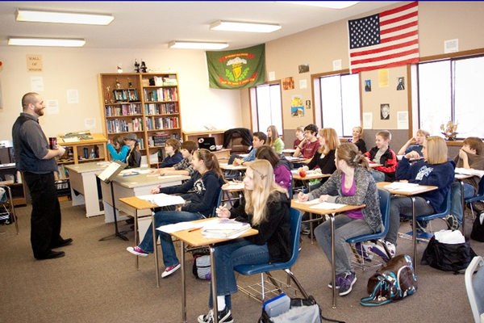
Research: Guided Pathways and High Schools*
Collaboration with HS curriculum
Colleges arbiter the standards of college readiness
Collaboration with HS counselors
Increasing the numbers of HS guidance counselors devoted to the college transition and SB 70
Aligning Pathways though Dual enrollment and pre-college interventions
*Building Student Momentum from High School into College (2016) https://www.jff.org/resources/building-student-momentum-high-school-college/
Notes:
Divide into

Slide 10
Research: Guided Pathways and High Schools*
Sharing mindset in HS Beyond Academic Readiness: Building a Broader Range of Skills for Success in College (2017) https://jfforg-prod-prime.s3.amazonaws.com/media/documents/Beyond-Academic-Readiness_020217.pdf
Sharing Data: How High Schools and Colleges Can Team Up to Use Data and Increase Student Success (2016) https://jfforg-prod-prime.s3.amazonaws.com/media/documents/Using_Data_to_Support_Success_-112816.pdf
Communication about metamajors/majors/career
Notes:
Divide into

Slide 11
What are your colleges doing to reach out to high schools specifically with Guided Pathways?
?????
Please place your responses in the chat
Notes:
Randy

Slide 12
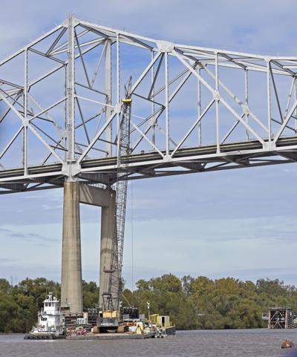
Bakersfield College Bridge to BC
It’s an Action-Packed, Hands-On, Freshmen Experience EVENT AND every single session includes:
Introduction to College Culture/Grit/Mindset/Time Mngmt.
Cross-Disciplinary Peer and Faculty Mentoring
Cross-Training Professional Development
Real-time Interaction with Campus Resources
Introduction to Guided Pathways
Intrusive Academic & Financial Advising
High-Touch, Online Technology Training
AND IT’S SCALABLE!
Notes:
Kimberlie and Janet

Slide 13
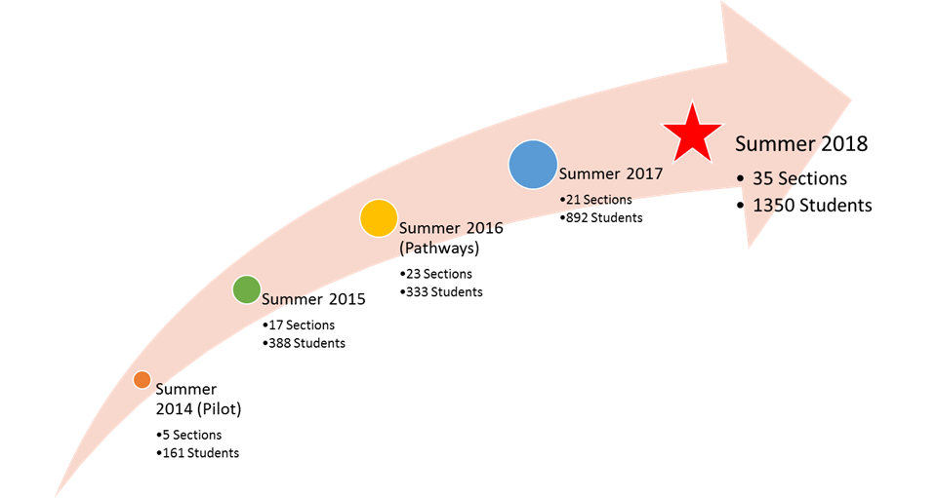
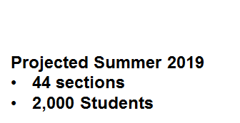

Slide 14
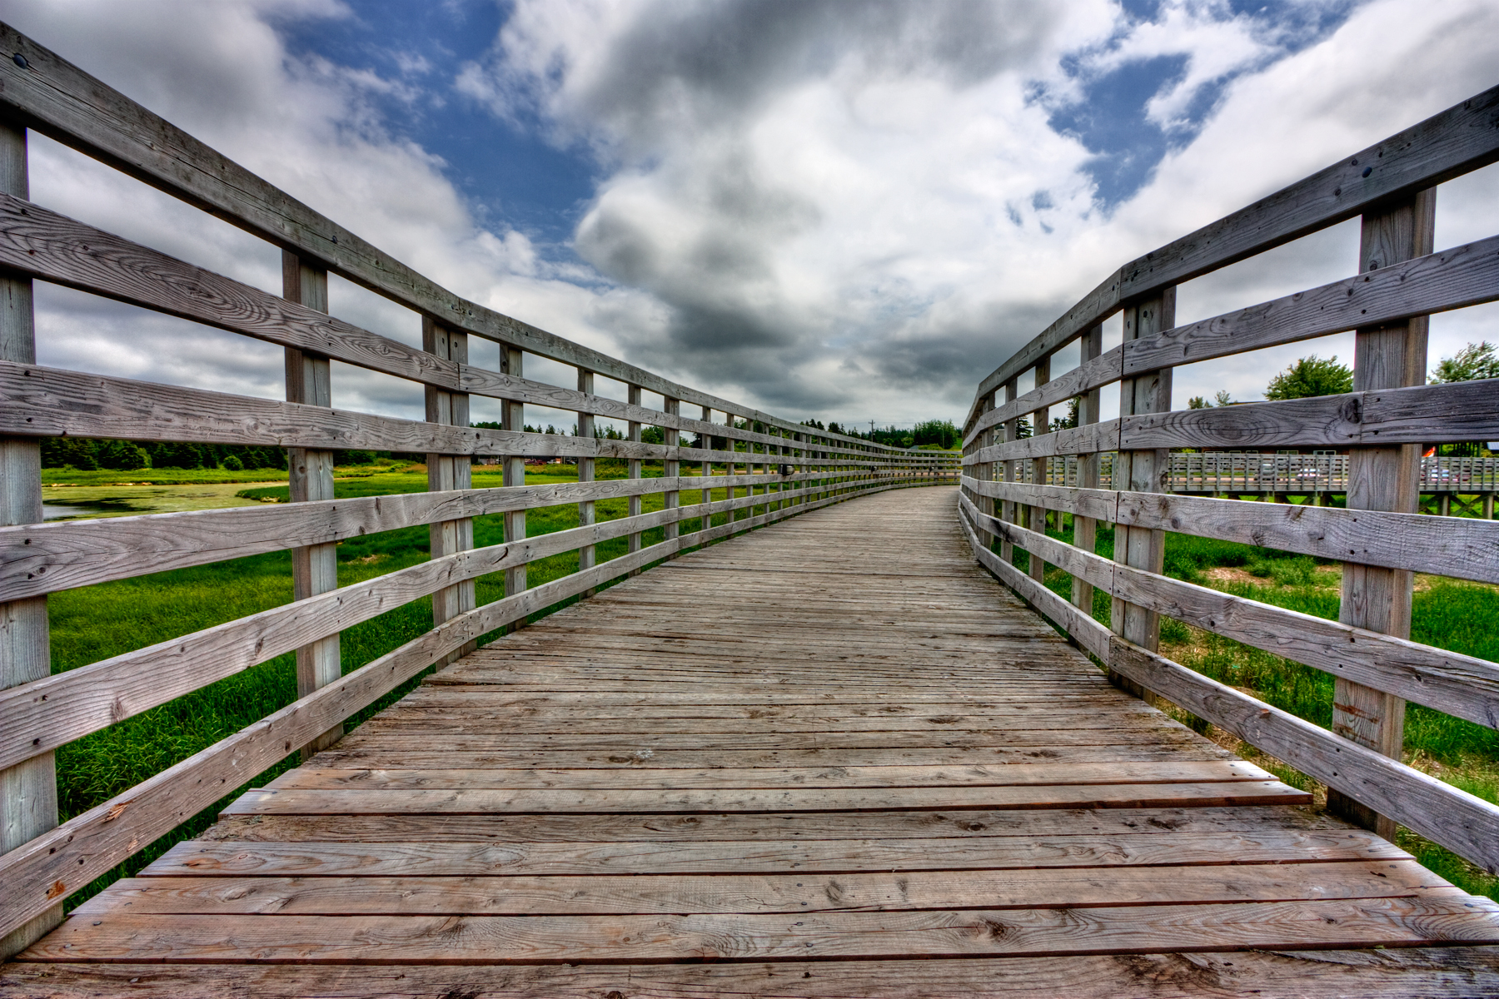
Bakersfield College Bridge to BC
Fall Outreach to High Schools
Session Planning
Classrooms
Food
Faculty and Staff sign ups
Spring Outreach Enrollment Workshops
Spring Outreach Registration at High Schools

Slide 15
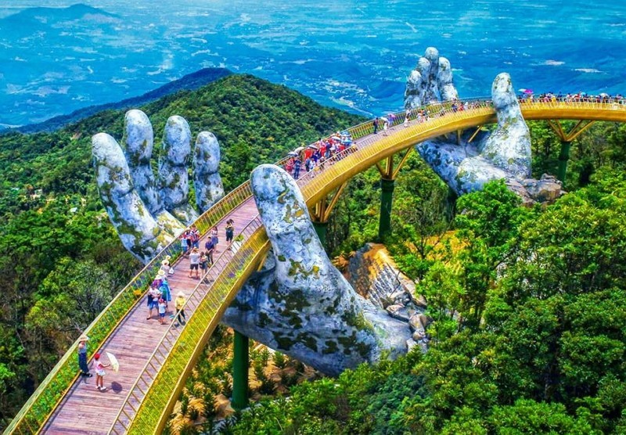
Bakersfield College Bridge to BC
Session Planning
Prescreen schedules
Send reminders
Prep materials
Lead Faculty Training
Follow up with no shows
Bridge to BC Family Night/Convocation

Slide 16
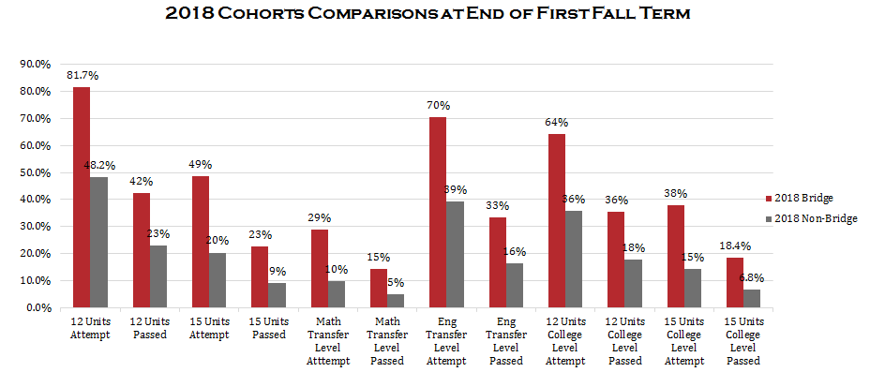
Bakersfield College Bridge to BC

Slide 17
SWC: Skills Gap Analysis
Curriculum and teaching practices alignment intended to support student transition and completion
Helps to clarify expectations
Establishes necessary skill-building to enter the path appropriately
Developing appropriate professional development to support faculty working with underprepared students

Slide 18
SWC: Skills Gap Analysis
Project Goals:
Sweetwater Union High School District (SUHSD) and Southwestern College (SWC) engaged in collaborative work for the purposes of:
Increasing college-going rates for SUHSD students right after graduation.
Increasing SUHSD student preparedness to succeed in college.
Improving SUHSD student success rates in transfer level English and Math courses in SWC (specifically ENG 115 and Math 244).
Hired consulting firm to guide the effort

Slide 19
SWC: Skills Gap Analysis
Gap Analysis
(Year 1)
Exit requirements of Integrated Math III with entrance requirements of Math 244
Identified potential gaps in instruction or curriculum
Closer analysis of potential gaps to identify 6 gaps of either curriculum or instruction
Aligned Course Expectations
(Years 1 & 2)
ACEs Created
Procedural
Conceptual
Application
Field tests of possible assignments in IM3 and Math 244
Refinement of ACEs and assignments based on field tests
Implementation & Communication
(Year 2)
Creation of MPAC Report
Alignment of ACEs within the IM3 curriculum
Canvas
Instructional Guides
End of Course Exams
Continue Professional Development for SUHSD Math Teachers to implement ACEs.

Slide 20
MATH Aligned Course Expectations
Students express solutions to inequalities symbolically, in Interval Notation, and graphically, on a number line; including cases when there is no solution and without the use of a calculator.
Students simplify expressions, solve equations, and graph functions with e and natural log at the same level of rigor as other bases.
Students use Polynomial Long Division to divide a polynomial with or without a missing term by a divisor with a degree less than or equal to 2.
Students solve linear Absolute Value Equations algebraically and recognize when there are no solutions, without the use of a calculator.
Students simplify and perform operations with Rational Expressions involving factorable polynomials.
Students solve Rational Equations by multiplying both sides by the LCD, and solve the resulting in linear or quadratic equation. Students recognize extraneous solutions.

Slide 21
Insights and Findings
Working together is not just productive, it is necessary, given recent curricular changes.
To better advise students
Understand each other’s instructional techniques
Gained deeper understanding of institutions on both sides.
Assessment and exit/entry requirements
Course placement options at SWC
Participating faculty can communicate the SWC experience to students
Developing lasting relationships among faculty at both institutions.
Increased communication about needs and resources

Slide 22
English and Writing Gaps
Student Independence
On-Demand vs. Process-Writing
Multiple draft writing process
Rigor and selection of texts
AXES format for paragraph development
MLA

Slide 23
Reading: Aligned Course Expectations
Students independently explain central ideas/claims/arguments in complex* texts.
Students independently define unknown words.
Students independently evaluate rhetorical techniques/strategies.
Students independently utilize annotation to deconstruct meaning of complex* texts.
Students independently evaluate the validity of the source.
Students independently evaluate the credibility of an author.
Students independently evaluate the credibility of the evidence.
Students independently connect multiple texts to a larger context/conversation.

Slide 24
Writing: Aligned Course Expectations
Students formulate defensible/reasonable conclusions based on claims and evidence in a text.
Students utilize feedback to revise multiple drafts (for example, revise for diction, style, tone, audience, purpose, genre, claim/argument).
Students craft complete sentence transitions (instead of signal words) to move from one central idea to the next.
Students compose topic sentence assertions (A). (An assertion is an arguable claim, instead of just a statement of fact.)

Slide 25
Writing: Aligned Course Expectations
Students accurately provide an example (X) of the strategies that are used by the source text/author.
Students explain/elaborate on (E) evidence.
Students accurately articulate the significance (S) of strategies/devices used by the author/source-text to achieve a purpose.
Students fluidly integrate source(s)/textual evidence using MLA format.

Slide 26
Final Product
A complete unit of work, including 5 individual assignments
Reading & Annotation
Paragraph Practice
Structured Rhetorical Precis
Essay Assignment
Peer Review Workshop
Teacher instructions, student instructions
Rubrics
Samples (text, completed assignments)

Slide 27
Final Product
Acknowledge Systemic Limitations
SWC
assessment/placement/MM
class size
Sweetwater Union High School District
(SBAC) standardized testing
pressure to pass/graduate
class placement
instructional interruptions
technology
Independence
academic behavior - habits of mind
workload responsibility

Slide 28
Questions and Comments

Slide 29
Two Webinars Next Week
The Reality of Metamajor and Program Mapping Work
Many colleges feel that the development of metamajors and program maps is the totality, or at least a major portion, of the Guided Pathways work, but is that true? Can you just create metamajors and program maps and be done with Guided Pathways? Colleges are spending significant time and effort engaged in sorting activities, which may assist in beginning the conversation, but is that the best data to use in this transformative process? What have colleges learned in the metamajor and program map development process and how may you benefit from their insights?
3:00–4:30 PM (May 22, 2019)
Developing Practices and Materials for Counseling
Guided Pathways BEGINS with the correct connection between the student's goals and reasons for attending college and the types of programs, scheduling and exploration available for students. How do we meet students where they are at and help them understand pathways and support available to help create rigorous goals and realistic plans? Join us as we begin to look at Guided Pathways counseling tools.
Noon – 1:00 PM (May 22, 2019)
Notes:
Randy

Slide 30
Additional Resources
ASCCC GP Canvas - https://tinyurl.com/CCC-GP2018
ASCCC Guided Pathways RESOURCES https://www.asccc.org/guided-pathways
Building Student Momentum from High School into College (2016) https://www.jff.org/resources/building-student-momentum-high-school-college/
Beyond Academic Readiness: Building a Broader Range of Skills for Success in College (2017) https://jfforg-prod-prime.s3.amazonaws.com/media/documents/Beyond-Academic-Readiness_020217.pdf
How High Schools and Colleges Can Team Up to Use Data and Increase Student Success (2016) https://jfforg-prod-prime.s3.amazonaws.com/media/documents/Using_Data_to_Support_Success_-112816.pdf

