Slide 1
Guided Self Placement and Onboarding: Understanding Pillar 2
Presenter Names
ASCCC Guided Pathways Regional Meetings
Fall 2019, 10:30-3:00
Notes:
Ginni will start and we introduce ourselves

Slide 2
Overview
Initial thoughts…
What is permitted?
Guided Placement, Self Placement, and Student Onboarding defined
Nationwide Research Results – Self Agency
Current Issues and Concerns
Important Onboarding components
Developing GSP or Onboarding at Your College
Resources
Notes:
Ginni

Slide 3
Learning Outcomes
Participants will be able to…
design and implement their own Guided Self Placement or Onboarding processes to meet the educational goals of their students.
Notes:
Ginni

Slide 4
Notes:
Ginni - Today, we are addressing Pillar II, but of course nothing we do should be in silos, so we will touch on other pillars as well.

Slide 5
What does this entail?
Your thoughts and listen?
Please say what you think this involves and then share your role at the college.
Notes:
Janet 5 minutes

Slide 6
§55522 English and Mathematics Placement and Assessment
Guided placement, Self-placement
(C) A district placement method may be based upon guided placement, including self-placement, if a student’s high school performance data is not available or usable with reasonable effort. District placement methods based upon guided placement, including self-placement, shall not:
(i) incorporate sample problems or assignments, assessment instruments, or tests, including those designed for skill assessment, unless approved by the Chancellor; or
(ii) request students to solve problems, answer curricular questions, present demonstrations/examples of course work designed to show knowledge or mastery of prerequisite skills, or demonstrate skills through tests or surveys.
Notes:
Ginni

Slide 7
But…what is Permitted? Memo AA 19-19
The Chancellor is providing provisional approval for districts that opt to develop guided placement and self-placement methods that require Chancellor’s approval.
The district must collect data to demonstrate that students benefit from the guided and self placement models implemented.
Data reported shall include throughput and successful pass rates, and the college’s placement results (e.g., the number of students assessed, the number of students placed into the colleges curricular offerings in English and mathematics/quantitative reasoning, and whether concurrent support was recommended, disaggregated by race and ethnicity).
Districts will be allowed no more than two years to innovate and validate their own guided and self placement methodologies.
Districts will be required to provide a preliminary report on their validation data after one year of implementation.
Notes:
Ginni

Slide 8
Onboarding, Guided Placement, Self Placement—Definitions
Guided Placement: A process or a tool used to encourage a student to reflect on his or her academic history and educational goals that may include the student evaluating their familiarity and comfort with topics in English or mathematics. After completing the process, students will receive their course placement.
Onboarding: A process of orienting a student to the college and the programs and courses offered. The process often includes collection of information from the student about the student’s educational and career goals, elements of the student’s life that may impact their studies, and additional information about the student’s educational and life experiences that will inform and assist the student to choose appropriate courses.
Self Placement: The process in which a student chooses their placement after consideration of the self-assessment survey results and other relevant factors.
From CCCCO Memo AA 19-19: AB 705 Guided and Self Placement Guidance and Adoption Plan Instructions
Notes:
Ginni

Slide 9
Guided Self Placement and Onboarding Let’s Dig in! Worksheet…
Notes:
Janet

Slide 10
Additional Data Consideration
Scales of Justice
Are we trading more students through transfer for wider equity gaps and more failures?
How can we tip the scales to optimize student success?

Slide 11
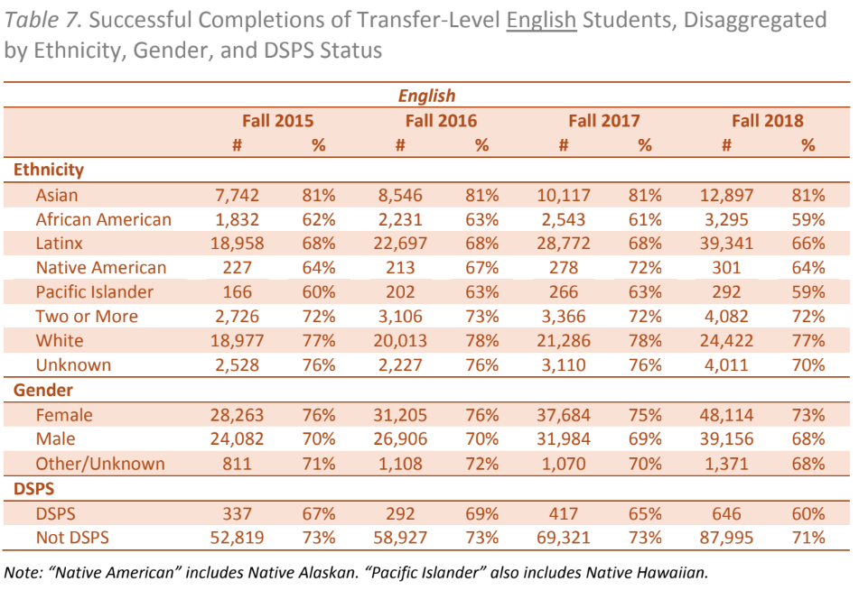

Slide 12
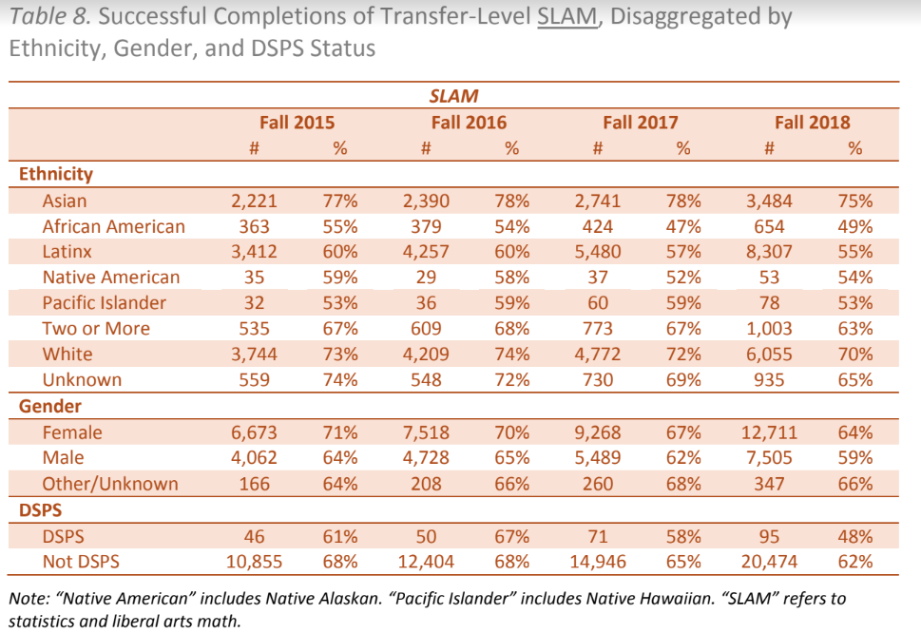

Slide 13
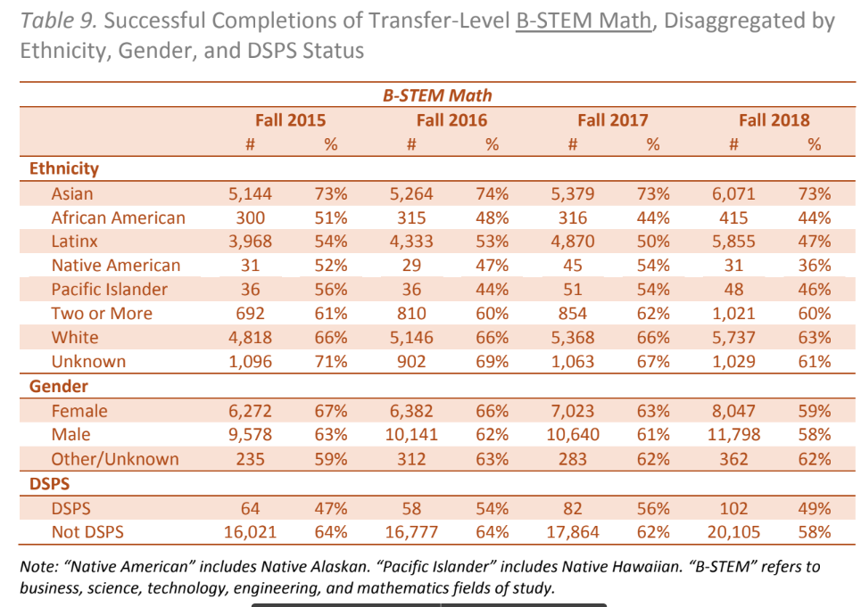

Slide 15
Nation-wide Studies on GSP or Onboarding
Notes:
Janet

Slide 16
Nation-wide Research Results – Self Agency
Higher Education is not done TO YOU but a Choice YOU MAKE
The focus
Adequate information (full disclosure) about programs and courses
Agency
Choice
Trust that students will make appropriate placement choices
(Royer & Gilles, 1998; 2003). Washington University
Nationally GSP is recognized as a High Impact Practice because it:
transforms student services and support into approaches that provide students the locus (Kuh & Chickering 2005; Schunk & Zimmerman, 2006; Shushok & Hulme, 2006; Toth, 2019; Weiner, 2000).
increases academic success, retention, graduation, and transfer rates What Works in the Community Colleges: A Synthesis of the Literature on Best Practices by Bourdon and Carduzzi (2002)
Notes:
Janet
Academic advising increases academic success, retention, graduation, and transfer rates, especially for "at risk" students from first generation, low-income families and students with disabilities. Academic advising, using both developmental and prescriptive approaches, gives students important information in order to make informed choices while also teaching those students who need assistance how to make informed choices. What Works in the Community Colleges: A Synthesis of the Literature on Best Practices by Bourdon and Carduzzi (2002)

Slide 17
Nation-wide Research Results – Self Agency
Toth (2019) warns that colleges should not seek a “tool” because:
“DSP is not a single procedure, product, or algorithm, but rather a set of principles grounded in student choice that can be implemented in a variety of ways with varying consequences in local contexts.
Those implementations often evolve over time as student bodies and curricula change and as new technologies and theoretical insights emerge.”
Notes:
Janet

Slide 18
Discussion with Q and A

Slide 19
Glendale College Process

Slide 20
Glendale College Early Outcomes

Slide 21
Resources used by ASCCC Guided Pathways Task Force
A practice guide for college and university administrators, advisors, and faculty. Washington, DC: Institute of Education Sciences, What Works Clearinghouse. https://ies.ed.gov/ncee/wwc/Docs/PracticeGuide/wwc_dev_ed_112916.pdf
What Works in the Community Colleges: A Synthesis of the Literature on Best Practices. INSTITUTION California Univ., Los Angeles. Graduate School of Education. PUB DATE 2002-12-00 NOTE 57p.; Prepared by the Higher Education and Organizational Change Division. https://pdfs.semanticscholar.org/909d/94498abfe9d8606994c319509f43ac6b06fa.pdf?_ga=2.264020940.1746833798.1553632938-1415424856.1553632938
Chickering, A. W., & Kuh, G. D. (2005). Promoting student success: Creating conditions so every student can learn (Occasional Paper No. 3). Bloomington, Indiana: Indiana University Center for Postsecondary Research.
IES, Strategies for Postsecondary Students in Developmental Education – A Practice Guide for College and University Administrators, Advisors, and FacultyWhat Works Clearinghouse https://ies.ed.gov/ncee/wwc/
Schunk, D.H. & Zimmerman, B.J. (2006). Competence and control beliefs: Distinguishing the means and ends. In Alexamder, P.A. & Winnie, P.H. (Eds.). Handbook of educational psychology (2nd ed.). Mahwah, NJ: Lawrence Erlbaum Associates.
Shushok, F. r., & Hulme, E. (2006). What's Right with You: Helping Students Find and Use Their Personal Strengths. About Campus, 11(4), 2-8.

Slide 22
Supporting a Focus on the Student Onboarding Experience: Resources from RP Group
Understanding the Student Experience Through the Loss/Momentum Framework: Clearing the Path to Completion (Research and Planning Group for California Community Colleges)
A guide to ensure students successfully transition through critical junctures in their educational journey, https://tinyurl.com/y5u93yxl
Student Engagement in Guided Pathways Development
An overview of six design principles for effective student engagement, https://tinyurl.com/y3ovco7w
Students Shaping Change: Engaging Students as Essential Partners in Guided Pathways Development
Resource demonstrating design principles for meaningfully partnering with students throughout redesign, with examples from Santa Monica College’s Student Advisory Squad, https://tinyurl.com/y4ay7xye
Collecting Student Voices for Guided Pathways Inquiry and Design: Why Do It, How It Works, and What It Looks Like in Action
A hands-on guide providing college stakeholders—particularly cross-functional teams—an introduction to engaging students in early GP development efforts, Found in the California Community Colleges Vision Resource Center at https://visionresourcecenter.cccco.edu/
New Student Onboarding Diagnostic: What First Impression Does Your College Make? (EAB)
A tool to assess key onboarding processes and how they can be improved or strengthened, https://tinyurl.com/y4fv5zgc
What We Are Learning About Guided Pathways (Community College Resource Center)
A summary of key practices from national Guided Pathways efforts including recommendations for strengthening onboarding practices, https://tinyurl.com/yyk4bv9p

Slide 23
National Recommendations for Onboarding
Recommendation 1: Use multiple measures to assess postsecondary readiness and place students.
Recommendation 2: Require or incentivize regular participation in enhanced advising activities.
Recommendation 3: Offer students performance-based monetary incentives.
Recommendation 4: Compress or mainstream developmental education with course redesign.
Recommendation 5: Teach students how to become self-regulated learners.
Recommendation 6: Implement comprehensive, integrated, and long-lasting support programs.
Notes:
Janet

