Slide 1
Quest/SmarterMeasure™
Learning Readiness Indicator™ (SM/LRI) Webinar Series

Slide 2
Welcome and Introductions
Anita Crawley, Readiness Coordinator, Online Education Initiative
Katie Winter, SmarterServices, Relationship Manager serving CCC’s
Linda Delzeit, Academic Technology Coordinator at LA Trade Technical College
Jon Knolle, Dean of Instruction, Monterey Peninsula College

Slide 3
Agenda
Moving from Quest/SM out-of -the box delivery to local customization
Quest – different strokes for different folks
SM – data, tracking, and reporting
MPC – badging, the basics
LATTC – deployment, badging, accountability
Discussion

Slide 4
Some Challenges (Institutional & Course Level)
How to know when students complete Quest?
How to target appropriate readiness services to student needs?
How to scale?

Slide 5
Quest – Pathways, Usage, Tracking
Prior to Day 1 through Week 3 (prospective, novice, and experienced online students)
Throughout Term (all online students)
Quest tracking in Canvas

Slide 6
Introduction to SmarterMeasure
SM is a Learning Readiness Indicator provided by SmarterServices
Assessment
Uses a Sequence of Activities
Measures the degree to which students possess the non-cognitive skills needed for success in an online, hybrid or technology-rich on-campus course
Does not rely on simple self-assessment questions
Immediate score and diagnostic interpretation of results to the student and to their college
Major benefits: Identify at-risk students, Increase Retention and Directs Students to resources and remediation

Slide 7
STEPS To Accessing the Data
LTI Integration
Logging in to Admin Panel
Admin.smartermeasure.com
Login credentials
Click Analytics
Select Search Criteria, Search

Slide 8
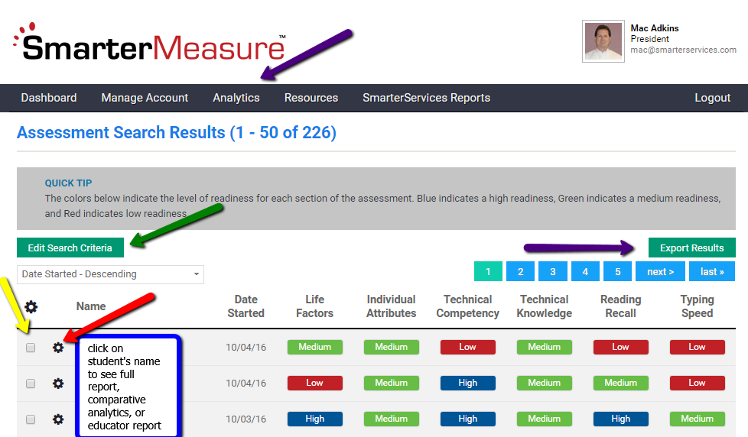

Slide 9
Badging At MPC
Jon Knolle
Dean Of Instruction
Monterey Peninsula College
jknolle@mpc.edu

Slide 10
LA Trade Tech Issues Digital Badges
Students can self-enroll in the Quest for Success class.
This is often done at the request of an instructor or counselor.
Link is located on Canvas Help Menu -> LATTC Canvas support page

Slide 11
Module Completion – Student View

Slide 12
Module Completion – Instructor View

Slide 13
Module Completion – Badge Issue

Slide 14
Manual Issue after Verification

Slide 15
Badge Issue - Automated

Slide 16
Student View of Badges Not Earned

Slide 17
Student View of Badges Earned

Slide 18
Students can Share a badge in multiple ways

Slide 19
LACCD Digital Badge Site

Slide 20
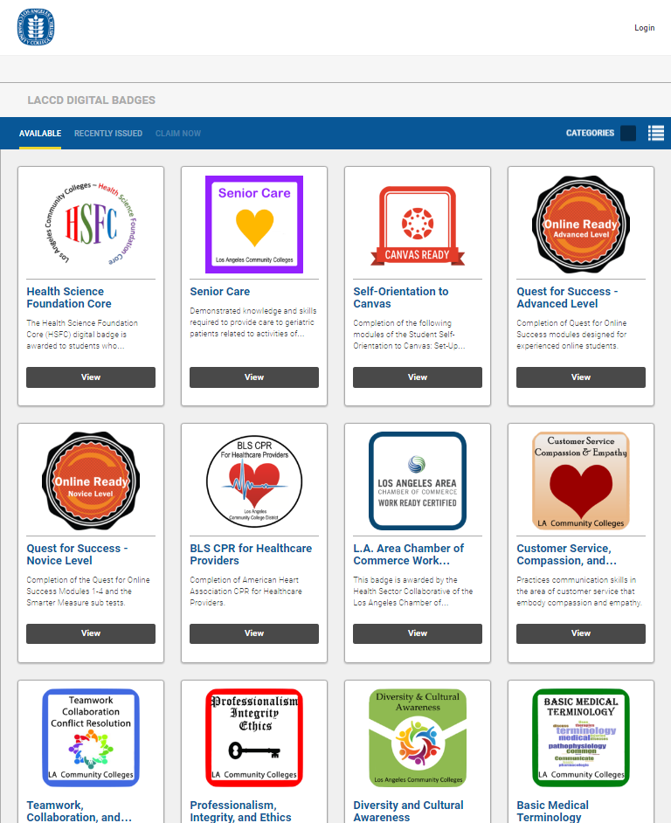
Shows All Available Badges

Slide 21
Shows recently earned and students who share

Slide 22
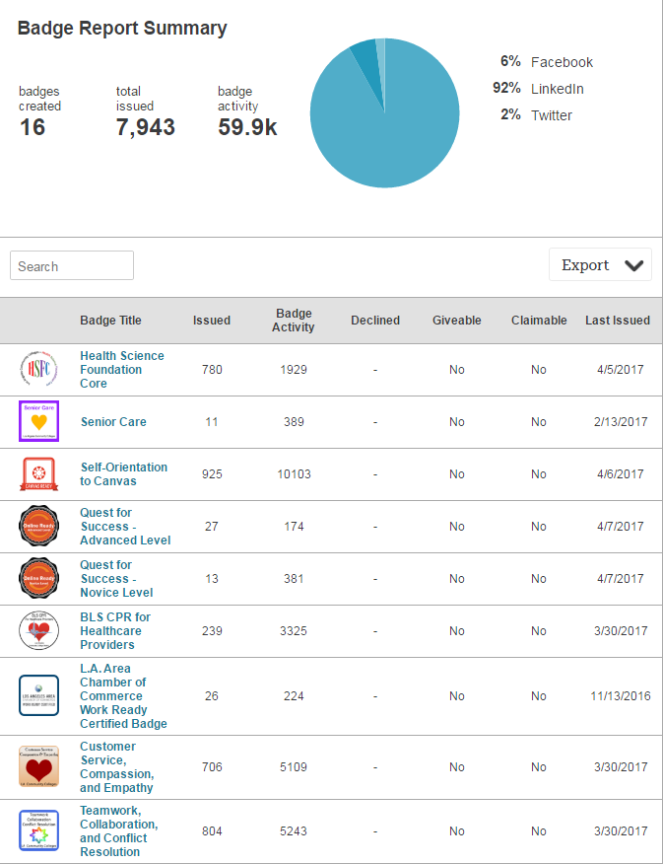
Badge Dashboard & Detailed Report

Slide 23
THANK YOU!
Linda Delzeit – DelzeiLD@lattc.edu

Slide 24
Next Steps
Continuing the conversation
Discussion Board =Readiness Resource Repository https://ccconlineed.instructure.com/courses/527
Best Practices Forum –example - Badging at LATTC with Linda

Slide 25
Contact Information
Anita Crawley: acrawley@comcast.net
Katie Winter: katie@smarterservices.com

