Slide 1
California Dual Enrollment - Business Model & ROI Research
Final Report
College Futures Foundation
August 2019

Slide 2
Dual Enrollment Summary by College
Bakersfield
Chaffey
ELAC
Instructional model = high school faculty
Districts: Kern, Delano, McFarland, Wasco, Wonderful (Charter), KCSOS, El Tahone
FY19 SA Size: 11,658
0% AB288 (courses offered during day and are open)
Instructional model = CC faculty
Districts: Chaffey Joint Union, Chino, Fontana, Upland
FY19 SA Size: 3,417
0% AB288 (all courses open and after school)
Instructional model = CC faculty
Districts: LAUSD, Montebello, Alhambra Unified
FY19 SA Size: 12,951
40% AB288

Slide 3
Calculating Net Revenue for Dual Enrollment
FTES Revenue: Dual Enrollment FTES * Special Admit reimbursement rate ($5,457); provided to college directly, not to the DE program itself
Program Revenue: Grants or general fund revenue appropriated to cover program expenses outside of instruction
Instructional Expenses: Faculty salaries, benefits
Indirect Expenses: Applied as a percentage of program costs or an assumption of time spent on DE from non-DE programs (such as admissions & records or counseling)
Program Expenses: Expenses needed to operate the program outside of instruction (salaries and benefits of program staff, textbooks, etc.)
Total Revenue
Total Expense

Slide 4
All Dual Enrollment Programs in Study Generate Net Positive Revenue
 | Bakersfield | Chaffey | ELAC
FTES | 1,166 | 347 | 1,295
FTES Revenue* | $6,361,771 | $1,864,548 | $7,067,361
Program Grant Revenue | $1,099,940 | $293,200 | $147,075
Program Other Revenue | $645,229 | $9,848 | $426,554
Total Revenue | $8,106,940 | $2,175,221 | $7,640,990
Instructional Expense | $964,562 | $456,675 | $2,842,485
Program Expense** | $1,745,169 | $293,200 | $573,628
Indirect Expense** | $523,551 | $182,287 | $172,089
Total Expense | $3,233,281 | $932,162 | $3,588,202
Net Revenue | $4,994,141 | $1,243,059 | $4,052,788
*Assumes full FTES conversion & $5,457 for Special Admit
**See research notes in appendix for a more detailed description

Slide 5
Net FTES Revenue per Credit of Dual Enrollment
Program-generated FTES revenue alone was enough to cover programmatic and instructional costs at all three programs, assuming a full reimbursement rate at $5,457 for Special Admit FTES. The table below shows how much net revenue is generated per course enrollment.
 | Bakersfield | Chaffey | ELAC
Net FTES Revenue per Credit of Dual Enrollment | $91 | $22* | $78
*Chaffey operates a similar program to ELAC in terms of instructional model, but this is a relatively new program and therefore is not benefiting from scale. The program has room to grow without increasing program expenses, which would ultimately lead to increased net FTES revenue.

Slide 6
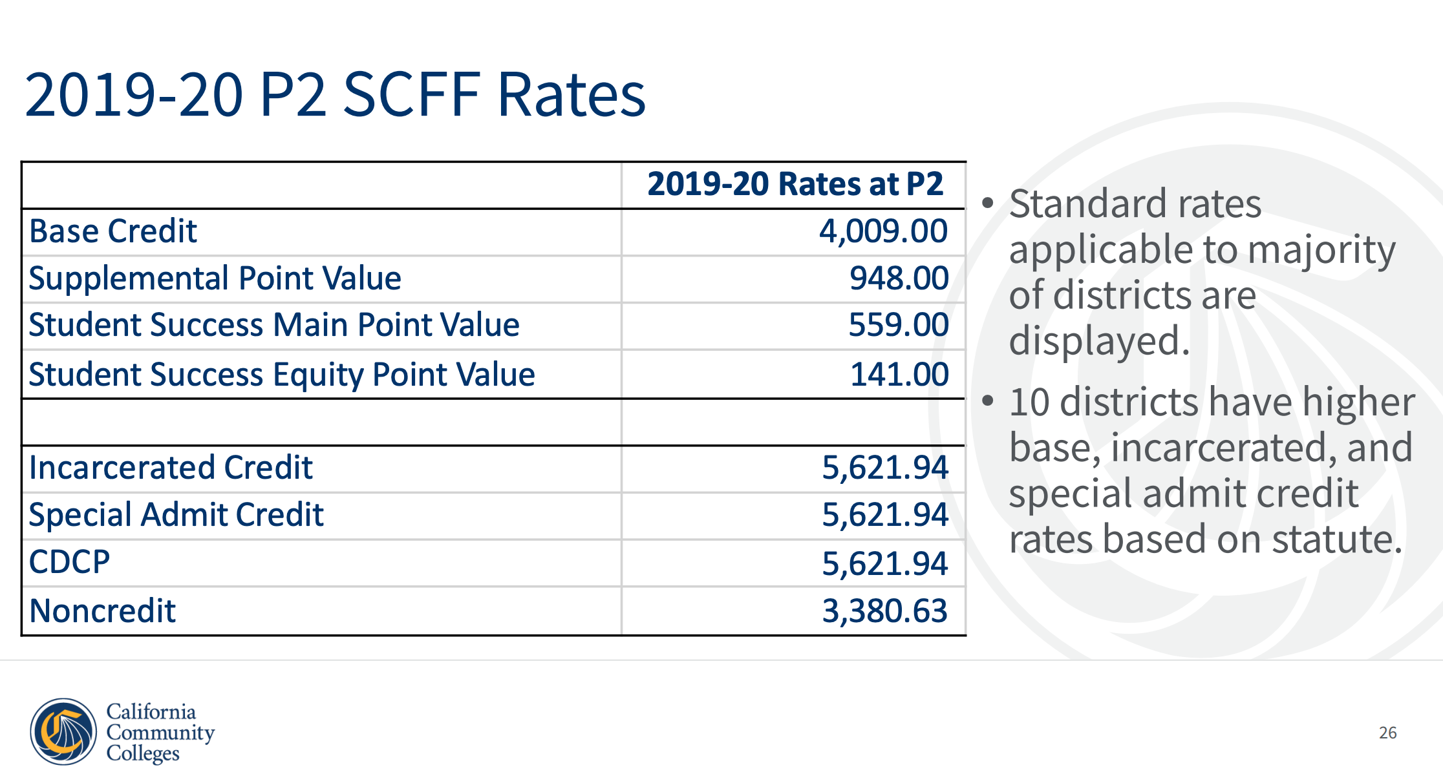
While it is best to work with your research office and academic division to determine the FTES for your sections, a quick and easy way to loosely estimate FTES is that every 10 students in a 3 unit lecture full term section equals 1 FTES.

