Slide 1
Creating Dual Enrollment Pathway Partnerships IE/Desert Region- Health Sector
February 16th, 2021
Brian Thompson, Manager College and Career Access Pathways

Slide 2
Topics for Flex Presentation
POP Quiz! Get ready to win a prize for your prior knowledge about DuE
What is a CCAPP? What is the difference between DuE and CoE
DuE growth at COD, Program pathways offered
What are the benefits of establishing a DuE Pathway through CCAP Agreements?
What is the process for which a new pathway is introduced?
Best Practices for inclusive and immersive DuE pathways in Health Education

Slide 3
POP QUIZ!
Who doesn’t love a Pop Quiz right at the beginning of class?
Even better you could win a $15 gift card to Starbucks that will be sent to you electronically via e-mail!
So get those phones out and visit

Slide 4
What is the difference of the Dual and Concurrent Enrollment program?
The Dual (DuE) and Concurrent Enrollment (CoE) program provides academic enrichment opportunities for special admittance high school students who complete College of the Desert coursework while still enrolled in their secondary educational pursuits.
These early college access opportunities are categorized in two offerings (Dual and Concurrent Enrollment) so what is the difference?
DuE refers to students participating in COD courses occurring on their HS campus sites and CoE refers to students take COD courses through our campus sites

Slide 5
What is a CCAPP agreement?
An agreement between the CC District and a local school district to offer college level courses on their campus sites typically with an embedded/approved adjunct faculty member that teaches at the respective school.
Agreements are creating under the legislature AB 288 which established regulation around Community Colleges offering more DuE courses to local school districts
CCAPP agreements are similar to a MOU or ISA but are valid for 5 years, auto renewing each year.

Slide 6
AB30- Legislative Changes
Changes Enrollment procedure requirements for Students participating in CCAP Dual Enrollment courses
Alters the CCAP board approval process to only require one board meeting for newly executed CCAP agreements
Allows students who participate in Dual Enrollment through CCAPs to be granted registration priority based on units completed

Slide 7
Dual Enrollment Pathways available at the K12 Partner Districts
PSUSD: General Education/Transfer Pathway (DHSHS, PSHS); Automotive CTE Pathway (RMHS); Education CTE Pathway (DHSHS); Public Safety Pathway (DHSHS); Theatre Arts CTE Pathway (PSHS); Digital Design and Production CTE Pathway (CCHS); Film CTE Pathway (CCHS); Spanish Language Pathway (PSHS)
DSUSD: General Education/Transfer Pathway (PDHS, SHHS); Automotive CTE Pathway* (Amistad HS); Culinary Arts CTE Pathway (LQHS); Public Safety Pathway (SHHS); Spanish Language Pathway (SHHS)
CVUSD: Film CTE Pathway* (CVHS, DMHS); CIS CTE Pathway* (CVHS); Public Safety Pathway (CVHS)

Slide 8
Fall 2020 Dual Enrollment- ON THE RISE!
Total Dual Enrollment Sections across all partnering districts=
- 33 Sections Fall 2020
- 22 Sections across 2020-2021
- 37 Sections Spring 2020
Total Concurrent Enrollment Sections = 8*
Total Dual Enrollment Unduplicated Students = 1053 vs. 647
Total Dual Enrollment Registrations= 1330 vs. 755
Total Concurrent Enrollment Undup. Students = 165 vs. 83*

Slide 9
Success by Discipline, Dual vs. Other

Slide 10
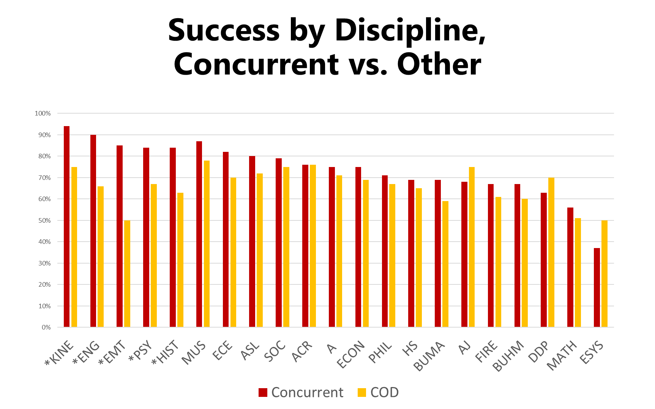

Slide 11
Benefits to Establishing Dual Enrollment Pathways in your Programs
Creating a college going culture in the Coachella Valley
Easing the transition between HS and College
Increased program enrollments through CTE pathways at the Academies (Creates pipelines of interested students into your program)
Increased exposure to students that may have never considered your institution as an option
Increased transfer students from your institution
Increased FTES for the college
Exposing non-traditional and first generation students to college courses in a lower stakes and higher support environment
Lowering equity gaps for at risk populations and groups.

Slide 12
Creating a DuE/CCAPP pathway process
Defining Interest from the K12 or COD in offering a certain pathway of courses
Introduction of the proposed pathway to specific schools/departments through DuE Liaisons
Identification of embedded instructor for the course from the HS site
Collaboration of HS instructor and COD instructor to discuss rigor and content of curriculum currently being offered and proposed to be offered
Creation of HR posting for evaluative interview process of proposed embedded HS instructor. They must meet CA state minimum quals
HR Onboarding of instructor
Scheduling of the course with assigned instructor and enrollment of special admittance High School students
Ensuring the school district provides needed books and curriculum materials

Slide 13
Best practices for establishing/established DuE pathways at your districts
Communication is KEY! Open lines of communication between my office, your department and the K12 school district/school site is essential when setting up new DuE courses and even after they are established.
Establish a K-14 Consortium group that meets monthly
Create the DuE School Faculty Liaison Program
Invite embedded DuE Faculty to your department meetings, provide them professional development opportunities and treat them as you would any other adjunct in your department.
Provide sample syllabi, course shells for canvas, and any other materials that will assist in offering the curriculum in the same rigorous format that is expected within your department.

Slide 14
Meet the Dual Enrollment School Liaisons
School of Communications- Kristie Camacho, English Dept.
School of Social Sciences and Arts- Laurilie Jackson, Media Dept.
School of Health Sciences and Education- Meredith Dillon, KINE Dept.
School of Applied Sciences and Business- Rory Pratt, Welding Dept.
School of Math and Science- Michael Silveira, Biology Dept.

Slide 15
What awesome information!! Comments? Concerns? Questions?
Mr. Brian K. Thompson
Manager, Career and College Access Pathways
bthompson@collegeofthedesert.edu
760.862.1396

